Slide 1
Intelligent Optimization Simulation Framework for T&E of Autonomous Systems
S. Snarski, PhD¹, A. Menozzi, PhD², B. Persons³, D. Lazar¹, N. Khan⁴
¹MTSI, VA
²Novus LLC, NC
³Persons Industries, AL
⁴Eight Queens, CA
DISTRIBUTION STATEMENT A.
Approved for public release; distribution is unlimited.
Notes:
Thank you and good morning.
On behalf of my coauthors: Steve Snarski, Brandon Persons, David Lazar, and Noel Khan, I am presenting our work from the paper: “Intelligent Optimization Simulation Framework for T&E of Autonomous Systems.”

Slide 2
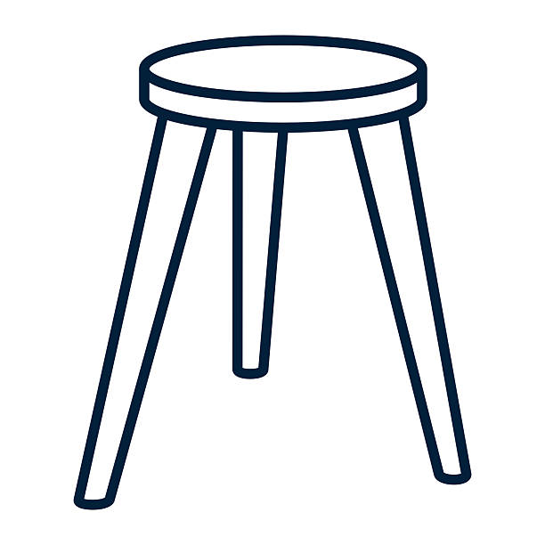
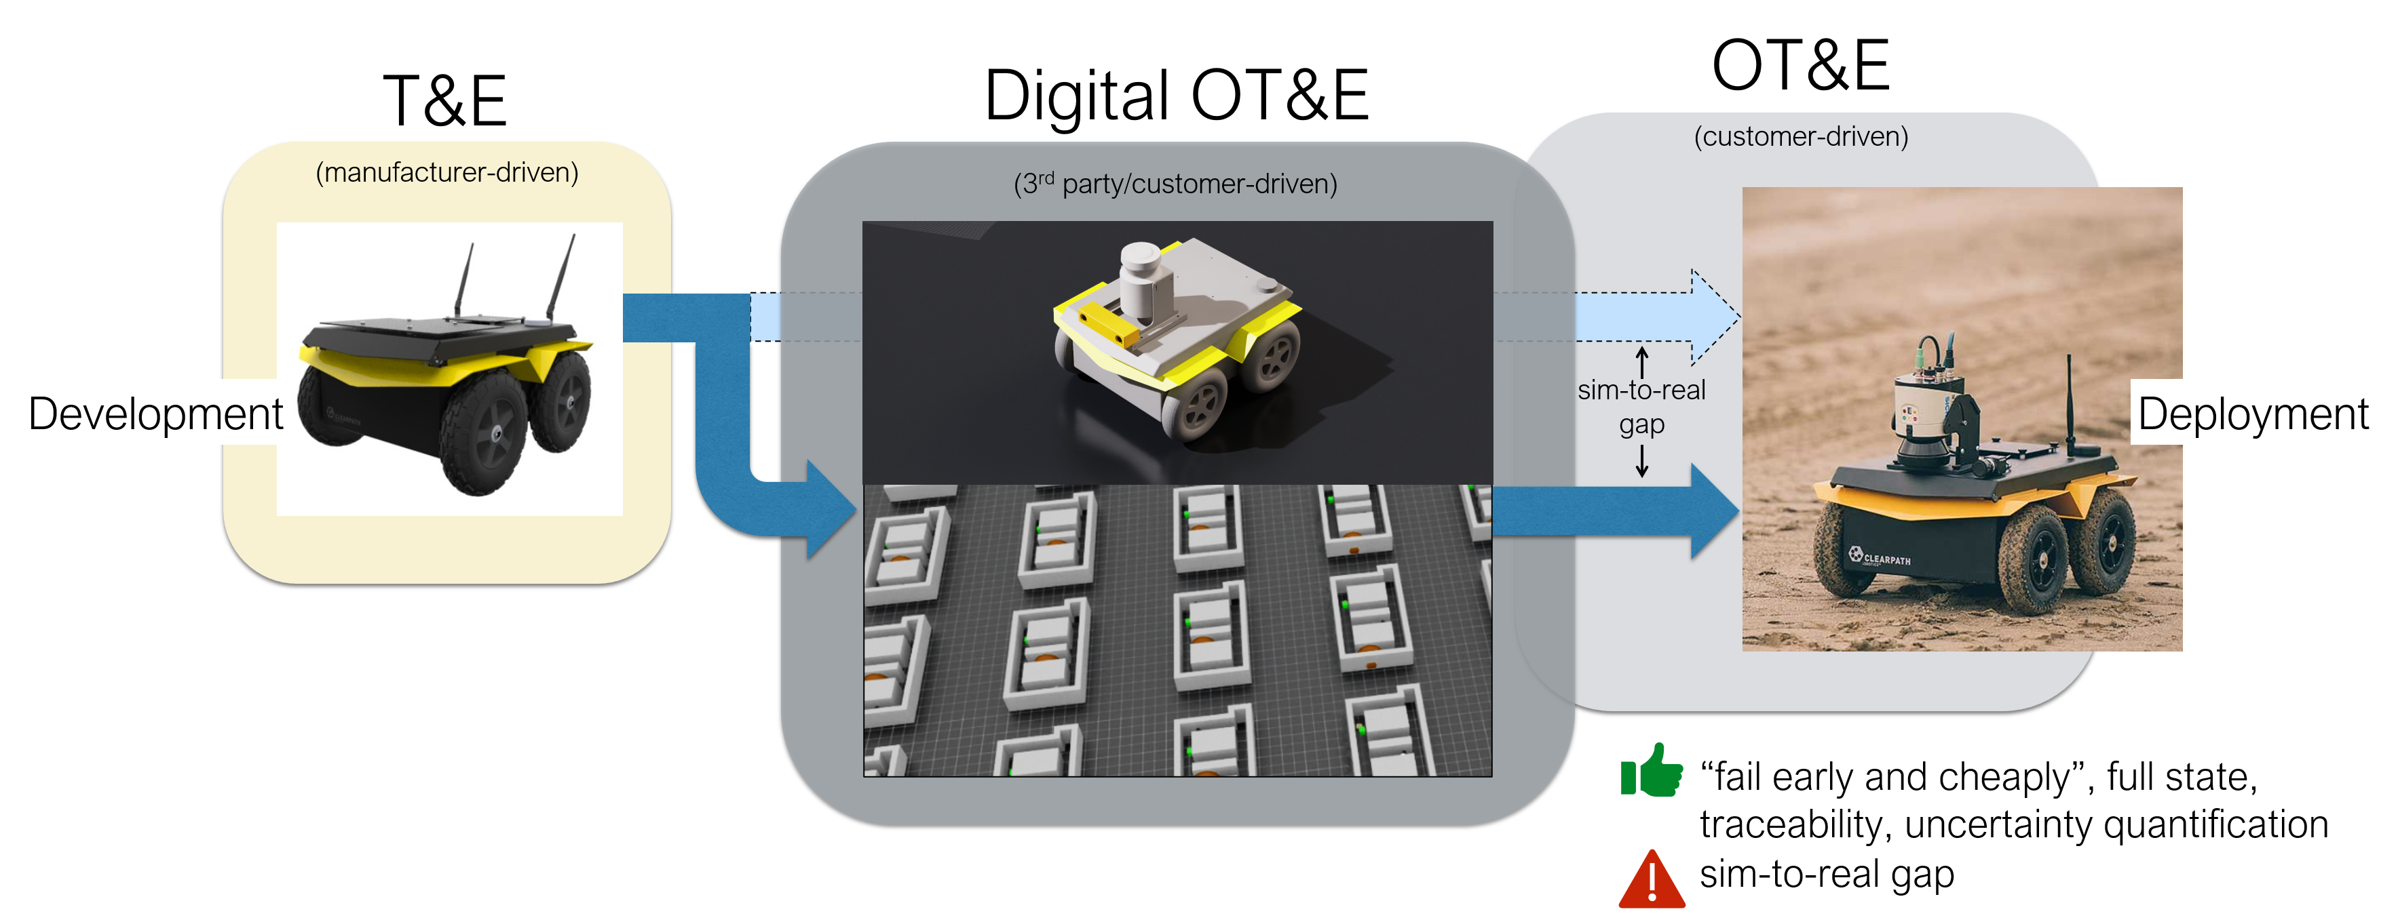
OT&E of autonomous systems
How to “ensure” that the integrated system will perform predictably and safely over time?
Scenario-based testing, accurate and efficient simulation infrastructure, uncertainty quantification (UQ) → digital OT&E
Testing tradeoff: outcome/safety risk vs deployment delay
Our objective: achieve an optimal balance by rigorously validating autonomous systems while enabling their deployment at a pace appropriate to stakeholder benefit and risk tolerance
Digital OT&E
UQ
Scenarios
Sim
Notes:
So, the problem we are talking about is operational testing and evaluation of autonomous systems
And the main question is: How do we “gain an acceptable level of confidence,” that the integrated system will perform predictably and safely over time in their envisioned operational environments?
The challenge is that ground-vehicle systems operate in complex environments, that are noisy, only partially observable.
Autonomous systems in general are likely to be black boxes, adaptive, and can have unpredictable behaviors.
[→] The consensus in the current state of the art is that the answer is based on scenario-based testing, accurate and efficient simulation, and uncertainty quantification.
We view these as the main components of digital OT&E.
[→] Digital OT&E is what we want to have in the path from development to deployment, where instead of going straight from manufacturer-driven T&E to pre-deployment OT&E we want to insert digital OT&E to “fail early and cheaply”, have access to the full state of the world for traceability, and quantify uncertainty.
Of course, this assumes that the gap between simulation and reality has been addressed and made negligible.
[→] Even with this capability the scenario space can grow very quickly, and it becomes impossible to test exhaustively. So we have a tradeoff, where insufficient testing creates unacceptable deployment risks and excessive testing creates unacceptable delays.
[→] So our objective is to achieve an optimal balance. Exactly where that is will depend on the problem and the stakeholder requirements.

Slide 3
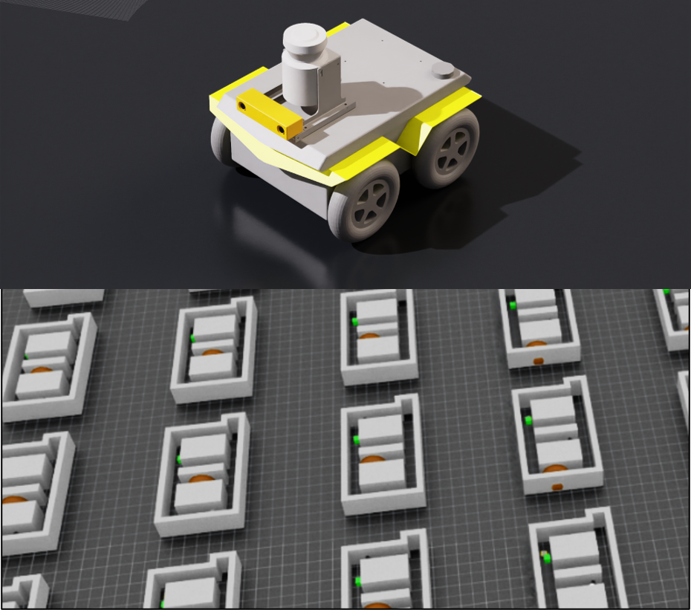

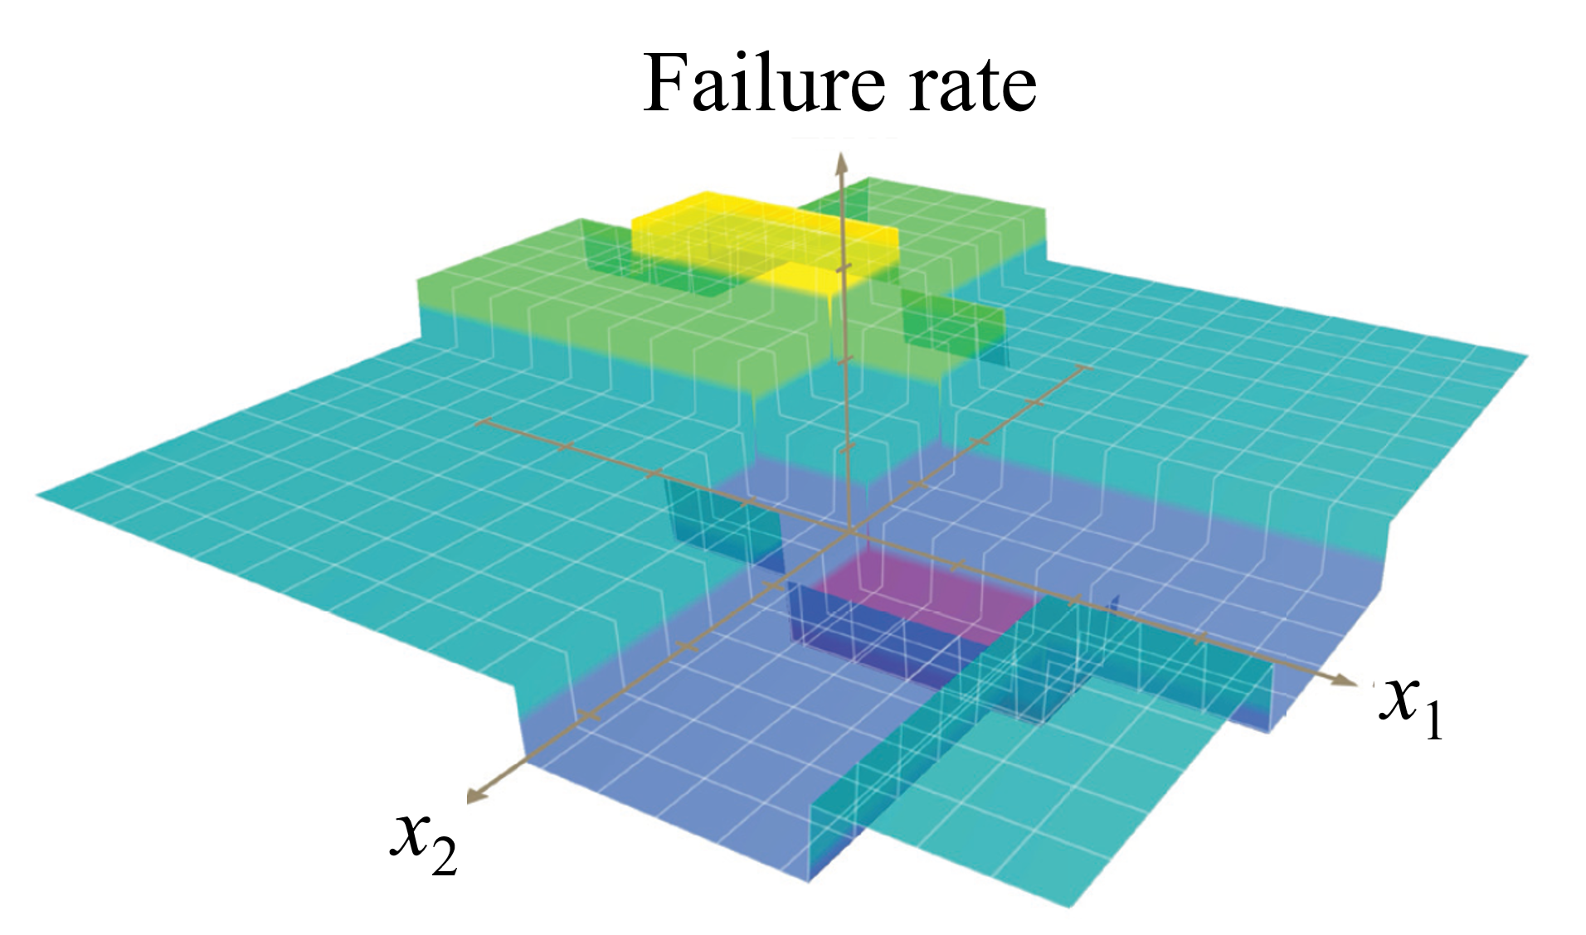
TEAAS: accelerating OT&E for autonomous systems
2025
B. Persons, S. Snarski, N. Khan, “Test and Evaluation AI-enabled Autonomous Systems,” in proceedings of AUVSI Xponential 2025, Technical Research & Platform Development Track, Houston, TX, 22 May 2025.
TEAAS (Testing & Evaluation of Advanced Autonomous Systems) is a MTSI IR&D effort
  Frames T&E as search for failure scenarios via realistic simulations (failure rate is objective value to maximize)
  Driven by stakeholder requirements
  Treats autonomy stack as a black box
  Addresses uncertainty (provides confidence metrics)
Key features:
  Statistically significant number of repeated runs for uncertainty quantification (UQ) and reduction
  Parallelized GPU-accelerated simulation with physics-accurate models
  Computational intelligence-based optimization (CIO)
TEAAS Concept
Simulated scenarios
stakeholders-driven requirements
Search / optimization
x
^
F(x)
Notes:
To address this issue, last year MTSI started an internal effort called TEAAS, that is Test & Evaluation of Advanced Autonomous Systems, and presented a paper at AUVSI describing progress up to that point.
[→] TEAAS frames T&E (and I will just say T&E instead of OT&E from now on) as an optimization problem where we look for scenarios that make the system fail.
We have a simulation component in which we can simulate arbitrary scenarios, controlled by a set of parameters x, and from which we can determine whether the mission failed or succeeded.
The mission, the scenarios, the parameters x, and what it means to fail or succeed are all stakeholder-driven requirements.
In fact, even the simulation itself could be a stakeholder requirement. We have chosen a certain simulation framework in this study, but we could just as well integrate other frameworks of interest, like AFSIM or the Army’s VANE, or MAVS.
Then we have a search/optimization component whose job it is to find scenarios, that is values of scenario parameters x, for which the mission is likely to fail.
In optimization terms, x are the optimization variables and failure rate is the objective value to maximize, which is computed by running each scenario (each x) N times and reporting the number of failures over N.
[→] Why N times? Because we are treating the autonomy under test as a black box. We do not want to draw conclusions from running a scenario just once. The autonomy could behave differently a second time, etc.
[→] So, we accumulate failure statistics, which has the added benefit of allowing uncertainty quantification and attributing confidence metrics to our conclusions.
The failure-rate space, the one where we are searching for high failure rates, ii most likely not a nice and smooth bowl-shape with a single maximum. It will be arbitrarily complex, with plenty of local maxima, flat regions, etc., which is not something that conventional local-gradient based optimizers can handle.
We will need a more intelligent optimization toolbox.
[→] Key features of the TEAAS concept are:
- Statistically significant number of repeated runs for uncertainty reduction and quantification
- Parallelized GPU-accelerated simulation with physics-accurate models, which means we can run the N simulations for each scenario in parallel
- Computational intelligence optimization (CIO), which I will describe later

Slide 4
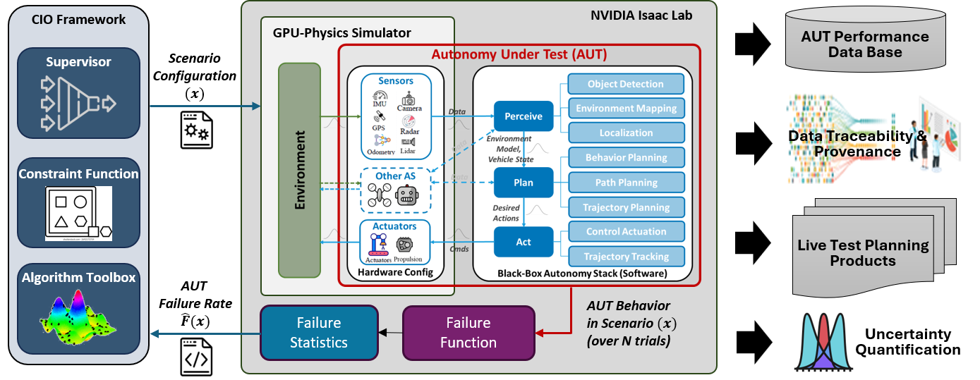
Current TEAAS framework
optimization infrastructure
simulation infrastructure
simulation realism
Output artifacts
Scenario definition
Failure definition
Output artifacts
uncertainty quantification
Notes:
This is our current implementation of the TEAAS concept.
[→] Starting from the left we have the Computational Intelligent Optimization piece. It has a set of algorithms, each being good at solving a particular class of problems. It allows the specification of constraint regions in the optimization space. And it has a supervisor utility that manages all that.
As mentioned earlier, it explores the space of scenario configurations (x) while trying to maximize the failure rate (F of x) of the autonomy under test.
[→] The simulation piece has the job of implementing the physics of the environment and of the autonomy under test.
[→] This is where the sim2real gap has to be closed (or closed enough).
What we are actually putting through T&E is the AUT’s software, the autonomy stack, which we integrate as given, including as a black box.
[→] As mentioned before, the basis for uncertainty quantification is running the AUT in each scenario N times and collecting statistics.
[→] The output artifacts include all kinds of data, due to having full state-of-the-world information.
[→] Again, the scenario definition, what constitutes failure, and what output artifacts are relevant are decided by the stakeholders.
So in the next few slides I’ll get into more detail about each of these pieces.

Slide 5
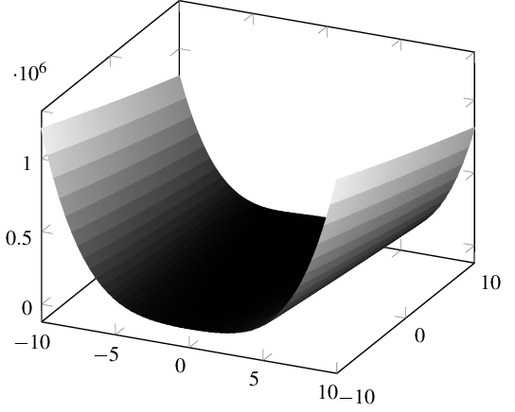
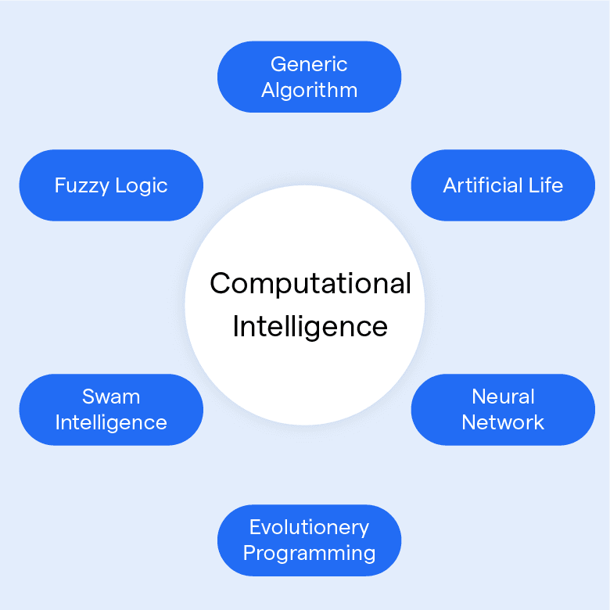
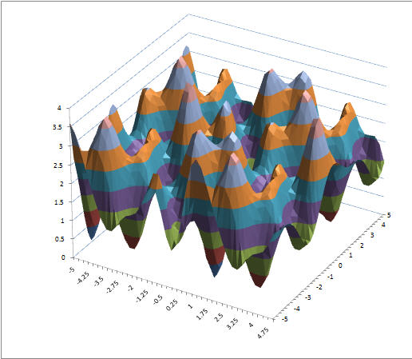
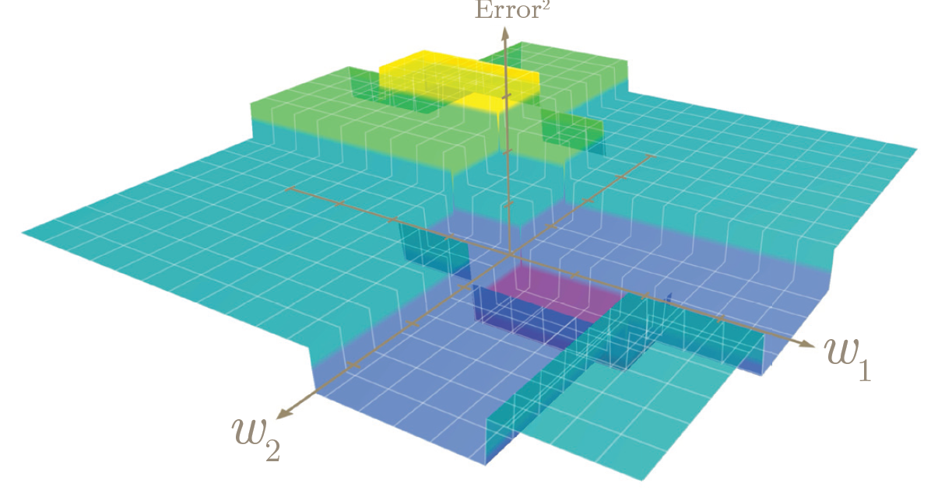
Optimization infrastructure
Computational intelligence-based optimization (CIO)
  Uses nature-inspired and learning-based methods (e.g., genetic algorithms, neural networks, fuzzy logic, particle swarms)
  Goal: find the best or near-best solution under constraints
  Used on hard real-world problems where classical optimization struggles
We implemented a toolbox with several customized algorithms (jDE, PSO, MAB, …) for TEAAS integration
Notes:
Our optimization infrastructure is CIO,
[→] which uses nature-inspired and learning-based methods, essentially blending AI and optimization.
[→] The goal is still to find the optimal solution, but these methods are used on hard problems, where classical optimization struggles, which is definitely the case here.
[→] Our objective function can turn out to be anything, including parts with flat areas, multiple extrema, hard transitions, and plateaus, which makes it hard to handle for conventional algorithms based on gradients and assumptions of smoothness.
[→] We implemented and customized several algorithms for integration with TEAAS.

Slide 6
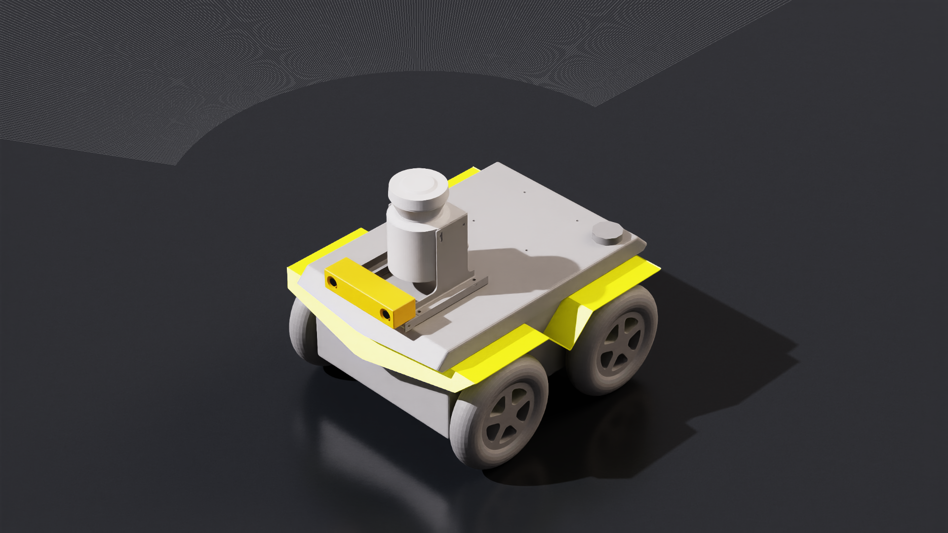
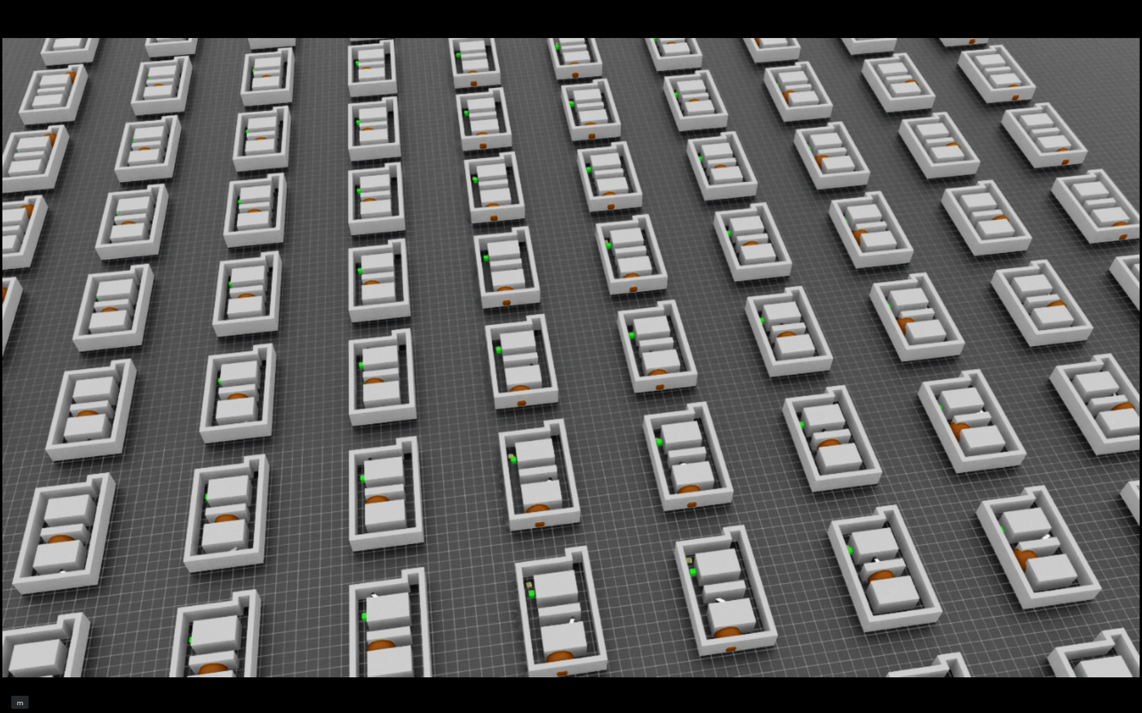
Simulation infrastructure
Based on NVIDIA’s Isaac Sim/Lab: open-source platform for creating, testing, and training AI-powered robots in realistic virtual environments
  GPU-accelerated multi-physics
  Supports accurate simulation of robots and sensors, including cameras and LiDAR
  Imports robotic systems from common formats (e.g., URDF, MJCF, CAD)
  Integrates with ROS
Typical use: vary (train) the AUT in a given environment
Our use: vary the environment for a given AUT
1000s of concurrent simulations possible on a single GPU
Notes:
The simulation infrastructure that we are using is NVIDIA’s Isaac Sim/Lab ecosystem.
[→] It uses GPU-accelerated multi-physics,
[→] has a library of robots and sensor models,
[→] it can also import models and
[→] can integrate with the robotics operating system.
[→] Its typical use is to train an autonomous system in a given environment. So for example using reinforcement learning to teach a robot how to do obstacle avoidance.
[→] Our idea was to flip that script. So in TEAAS we keep the AUT constant and vary the environment.
[→] So we have one robot and many environments, and we take full advantage of NVIDIA’s key features, so we can run thousands of environments in parallel on a single GPU.

Slide 7
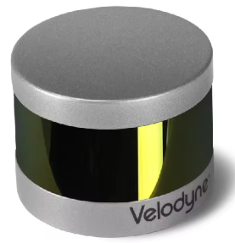
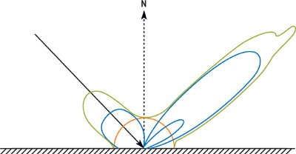
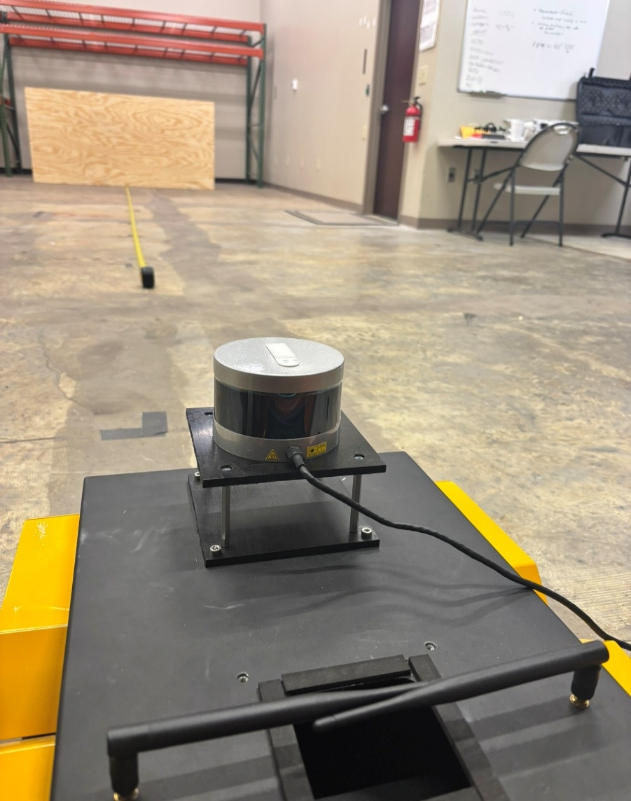
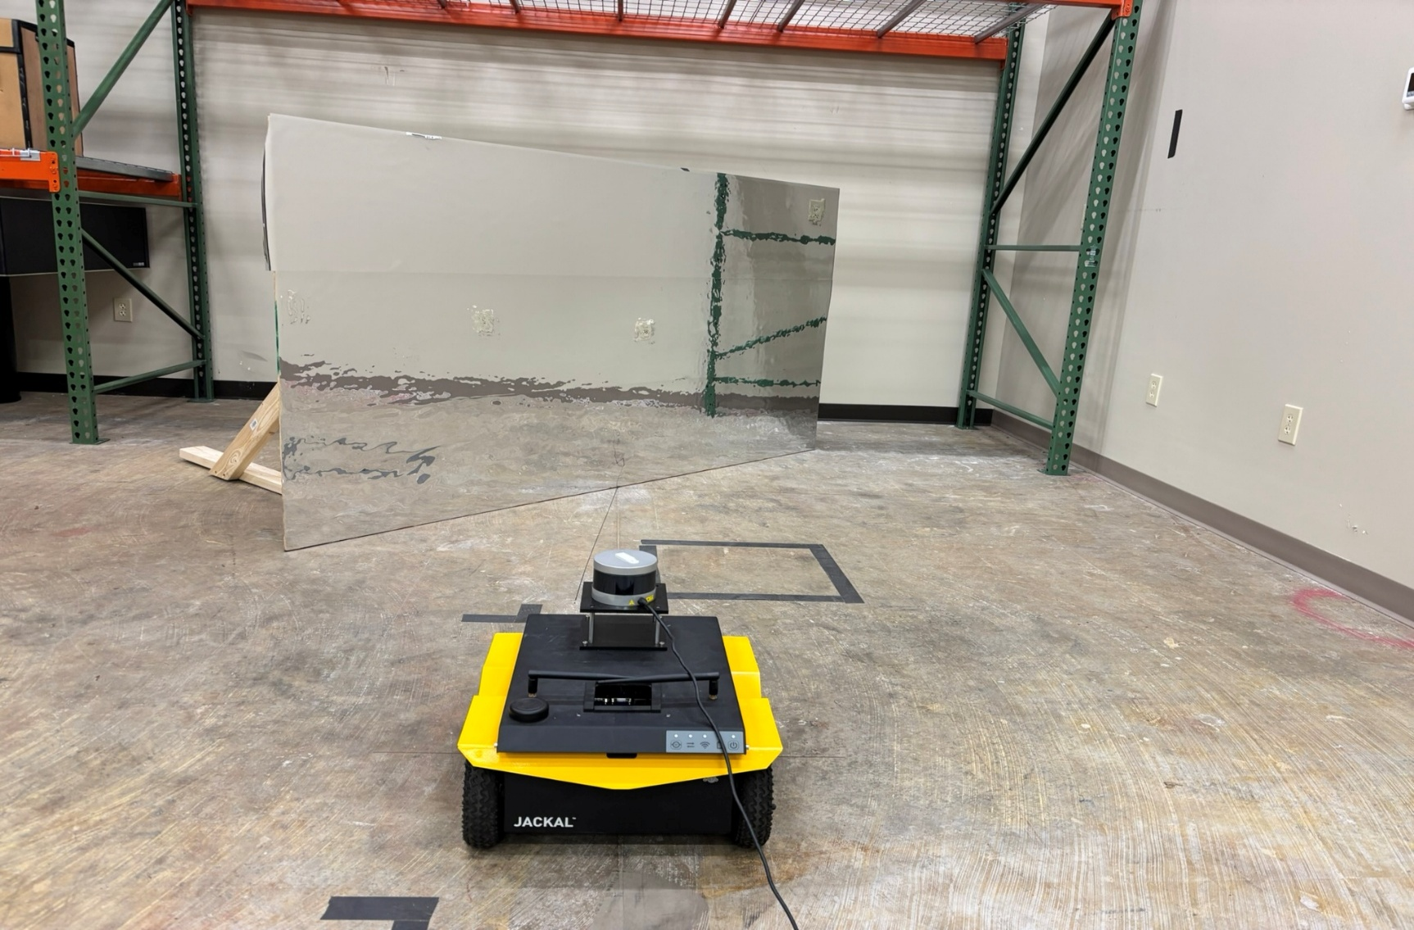
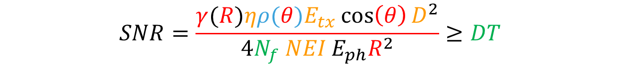




Simulation realism
Bridging the sim-to-real gap: must address both aleatoric (random) and epistemic (model) uncertainty
Largest source of error is often not vehicle dynamics but perception → sensor realism is mandatory for testing AI-enabled software
Case-study sensor modeling
  “Collision” lidar, RTX lidar, ANSYS lidar
Validation experiments
$$ρ(θ)$$
$$E_{tx}$$
Lidar
$$R$$
BRDF
$$θ$$
Sensor properties
Environment conditions
Target material property
Signal processing
$$SNR=\frac{γ(R)ηρ(θ)E_{tx}\cos\left(θ\right)D^{2}}{4N_{f} NEI E_{ph}R^{2}}≥DT$$
NOTE: TEAAS is “simulation agnostic”
Notes:
The simulation should be good enough so that the sim-to-real gap is negligible, and that depends on the problem.
Meaning, the accuracy of the random processes and of the models that are being used should be good enough.
[→] Usually, the most important factor is sensor realism.
[→] So, as part of our case study, we investigated different levels of fidelity in a LiDAR model.
[→] We validated the various models in the lab, where we collected real returns from a variety of materials and angles.
[→] As mentioned before, TEAAS is simulation agnostic. That is, we will integrate whatever simulation or model is required by the stakeholder.
That being said, MTSI is also actively involved in developing accurate simulations and models.

Slide 8
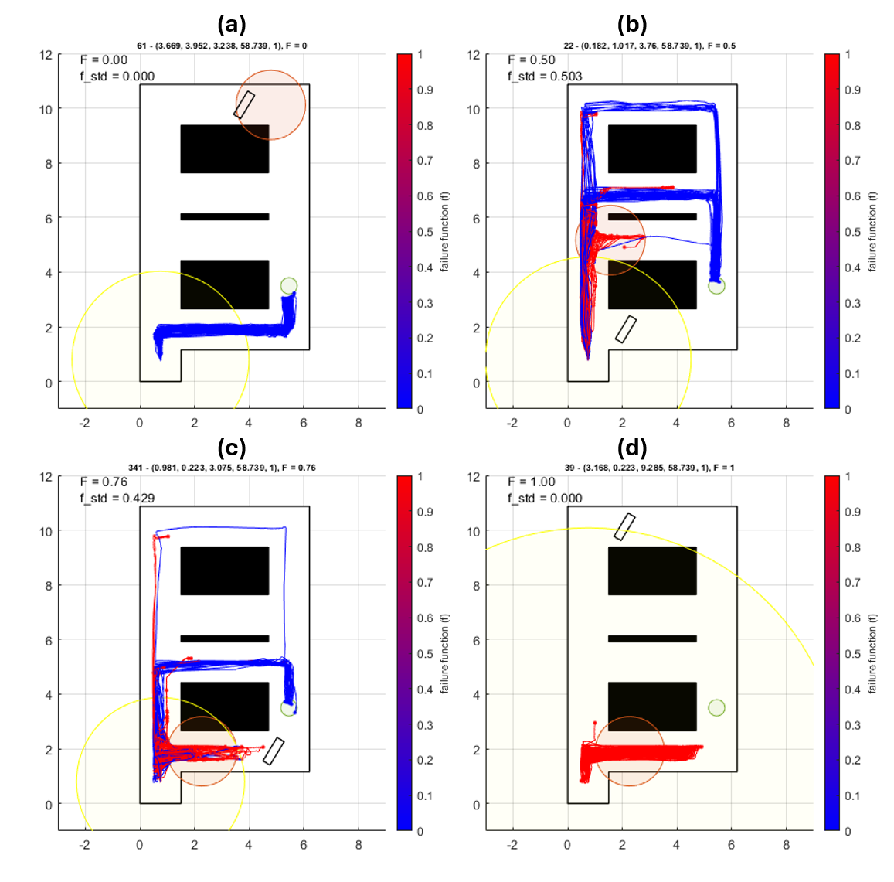
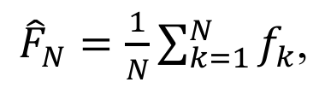
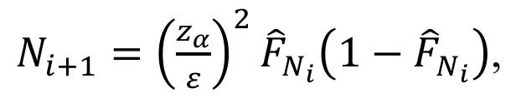
Uncertainty quantification
Randomness → must execute repeated experiments
Failure rate measurement and its benefits
    Inherently addresses uncertainty in AUT’s behavior
    The details of what it means for the AUT to fail or succeed are purposely kept separate from the CIO module
    No complex/convoluted objective function
Choosing the number of repeated sims
f : definition of failure
Notes:
Random variables are part of T&E and the way to handle randomness is to run repeated experiments.
[→] For example, here is a robot that must get to a goal, in four different scenarios… We ran each scenario 100 times and you can see that the robot behavior varied even within the same scenario.
The bottom line is that repeated experiments are needed to properly assess an AUT, and a T&E framework that does not provide that cannot produce reliable assessments.
The ability to repeat the test many times under precisely the same scenario is a critical asset of TEAAS because it gives it the ability to isolate the variability that is only due to the AUT.
[→] Since the measured failure rate is an estimate of the probability of failure, computed with N trials, it inherently addresses the uncertainty in the AUT’s behavior.
[→] The details of what it means for the AUT to fail or succeed are kept separate from the CIO module, which only receives failure-rate measurements.
That’s a consistent measure of performance, regardless of scenario, AUT, stakeholder requirements, or anything else.
[→] All the complexity is relegated to the failure function. This is where the specifics of the problem and stakeholder requirements come into play.
[→] Finally, the number of repeated sims can be computed adaptively, depending on desired confidence and error metrics.

Slide 9
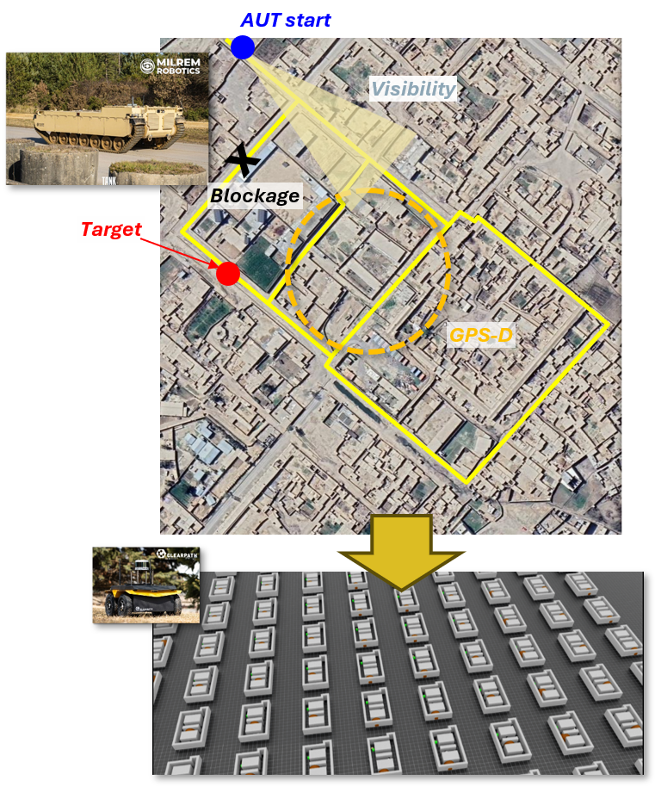
Case study: urban precision strike
Mission: navigate contested urban corridors
Scenario variables*: GPS-D zone location, VDE, obstacle location, angle, and material properties
Evaluating one ground-vehicle platform (Jackal robot) with two different autonomy stacks and two different LiDAR sensors
* Scenario variables include categorical variables (material properties) and custom symbolic location encoding. Therefore, the optimization search space is non-metric and not amenable to conventional optimization. In practice, this is the norm rather than the exception.
Notes:
The case study is an urban precision strike mission where an autonomous ground vehicle must get to a goal while negotiating various issues like GPS-denied areas and obstacles…
[→] We evaluate the same platform with two different autonomy stacks and two different LiDAR sensors…
We did this because we have a replica in the lab that we can use for validation.
[→] Note that even in this case, the problem cannot be solved by conventional optimization…

Slide 10
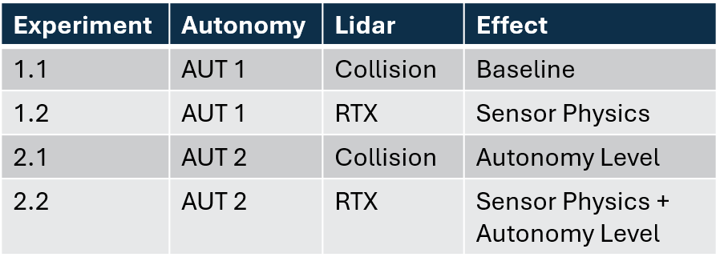
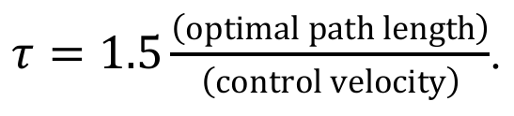
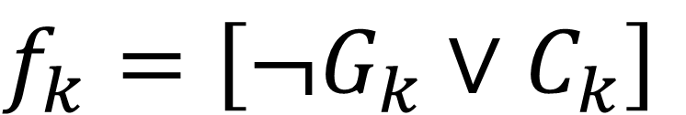
Simulation experiments
AUT variables
  Hardware: Collision lidar vs RTX lidar
  Software: AUT 1 stack vs AUT 2 stack (black boxes)
Measuring AUT performance: we define a failure function f that returns 1 if either of two failure modes are true: (a) failure to reach a specified location within a time limit, or (b) colliding with an obstacle in the environment:
$$f_{k}=\left[{¬G}_{k}∨C_{k}\right]$$
Notes:
The AUT variables…
[→] Measuring performance via failure rate means having to define a failure function…
Logging the reason for failure for explainability…

Slide 11
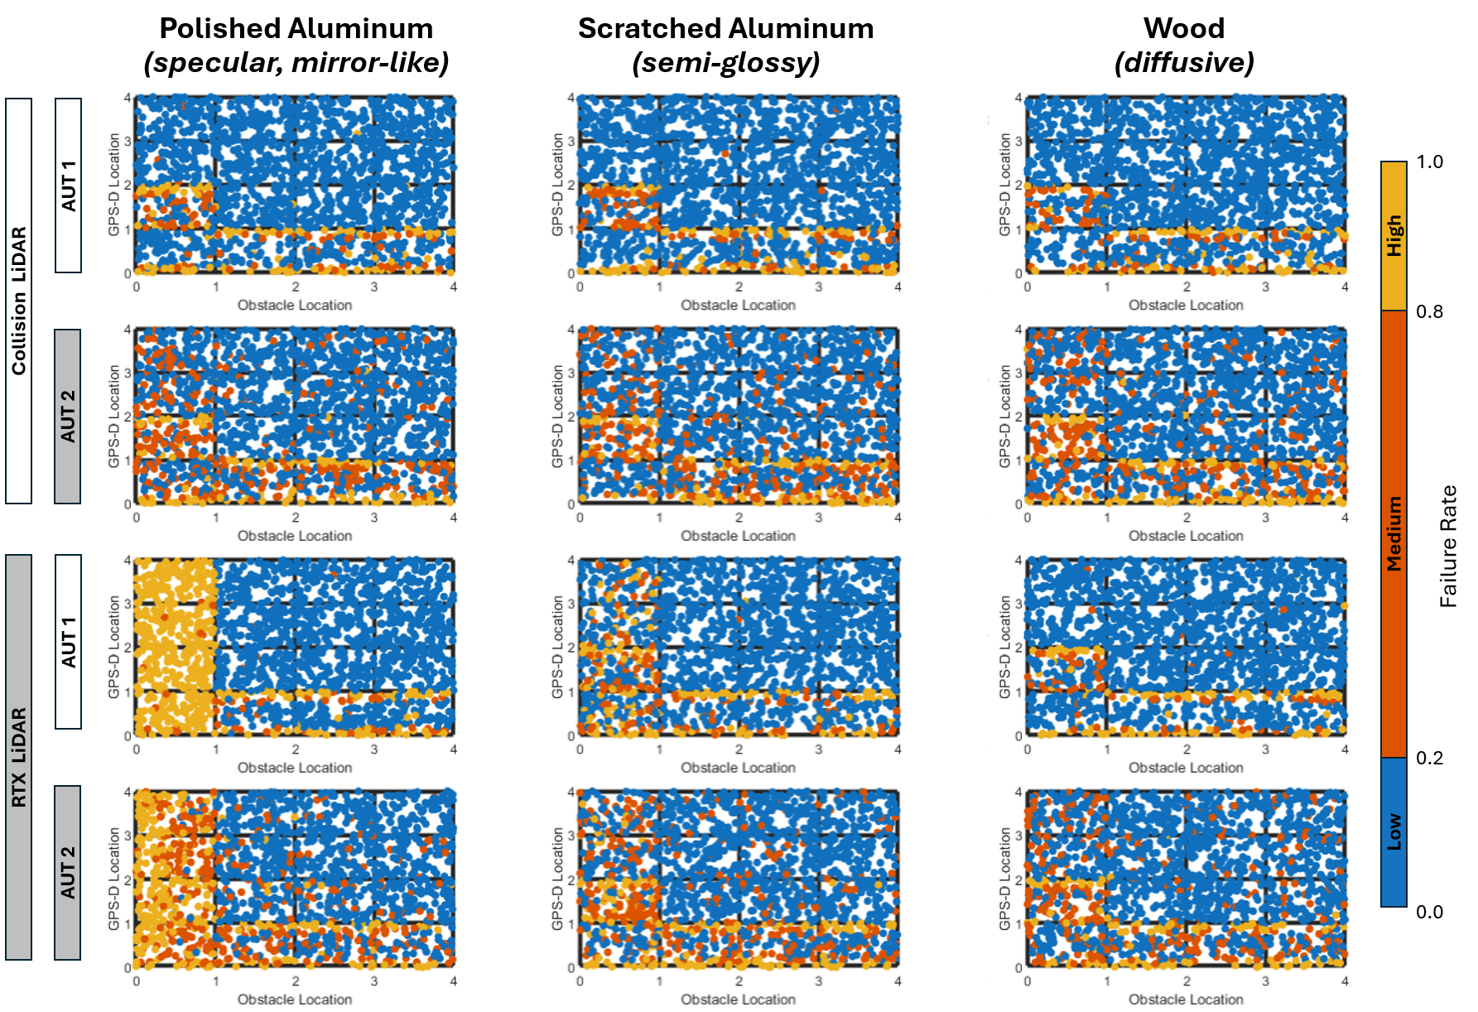
Baseline performance surfaces
Monte Carlo sims (50K) to generate baseline “performance surfaces”
Important variables identified through F-test ranking
These results show the impact of sensor realism and autonomy level and provide a baseline for evaluating the CIO results
Notes:
We first generate the baseline performance surfaces via many Monte Carlo simulations to randomly cover the whole space…
Scatter plots of the Monte Carlo data sets for all four simulation experiments using the variables identified through importance-ranking (via F-tests)…
These plots show…

Slide 12
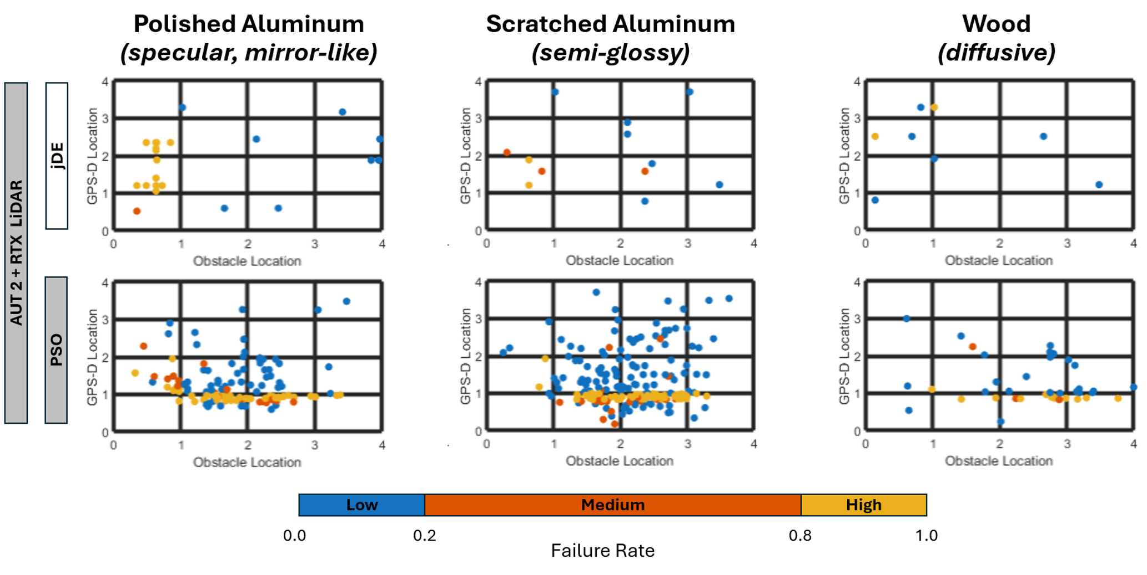
Efficient scenario search with CIO’s algorithm toolbox
Differential evolution (jDE)
  Simulates evolution by natural selection; retain worst of each population, create offspring from parents attributes, allow random mutations
  Identifies one critical region (specular surfaces) with; additional runs identify other failure regions
Particle Swarm Optimization (PSO)
  Simulates swarm behaviors; candidate values drift through search space based on own performance and best solution found by swarm
  Identifies two critical regions: GPS-D and specular
CIO algorithms increase efficiency (vs MC) by orders of magnitude (see our 2025 paper)
CIO supervisor module manages multiple optimization algorithms
Notes:
jDE finds one thing and PSO finds another…
[→] CIO is much more efficient than MC…
[→] CIO will try and combine different algorithms with different properties…
It will also adapt constraints as the search progresses to make it more efficient…

Slide 13
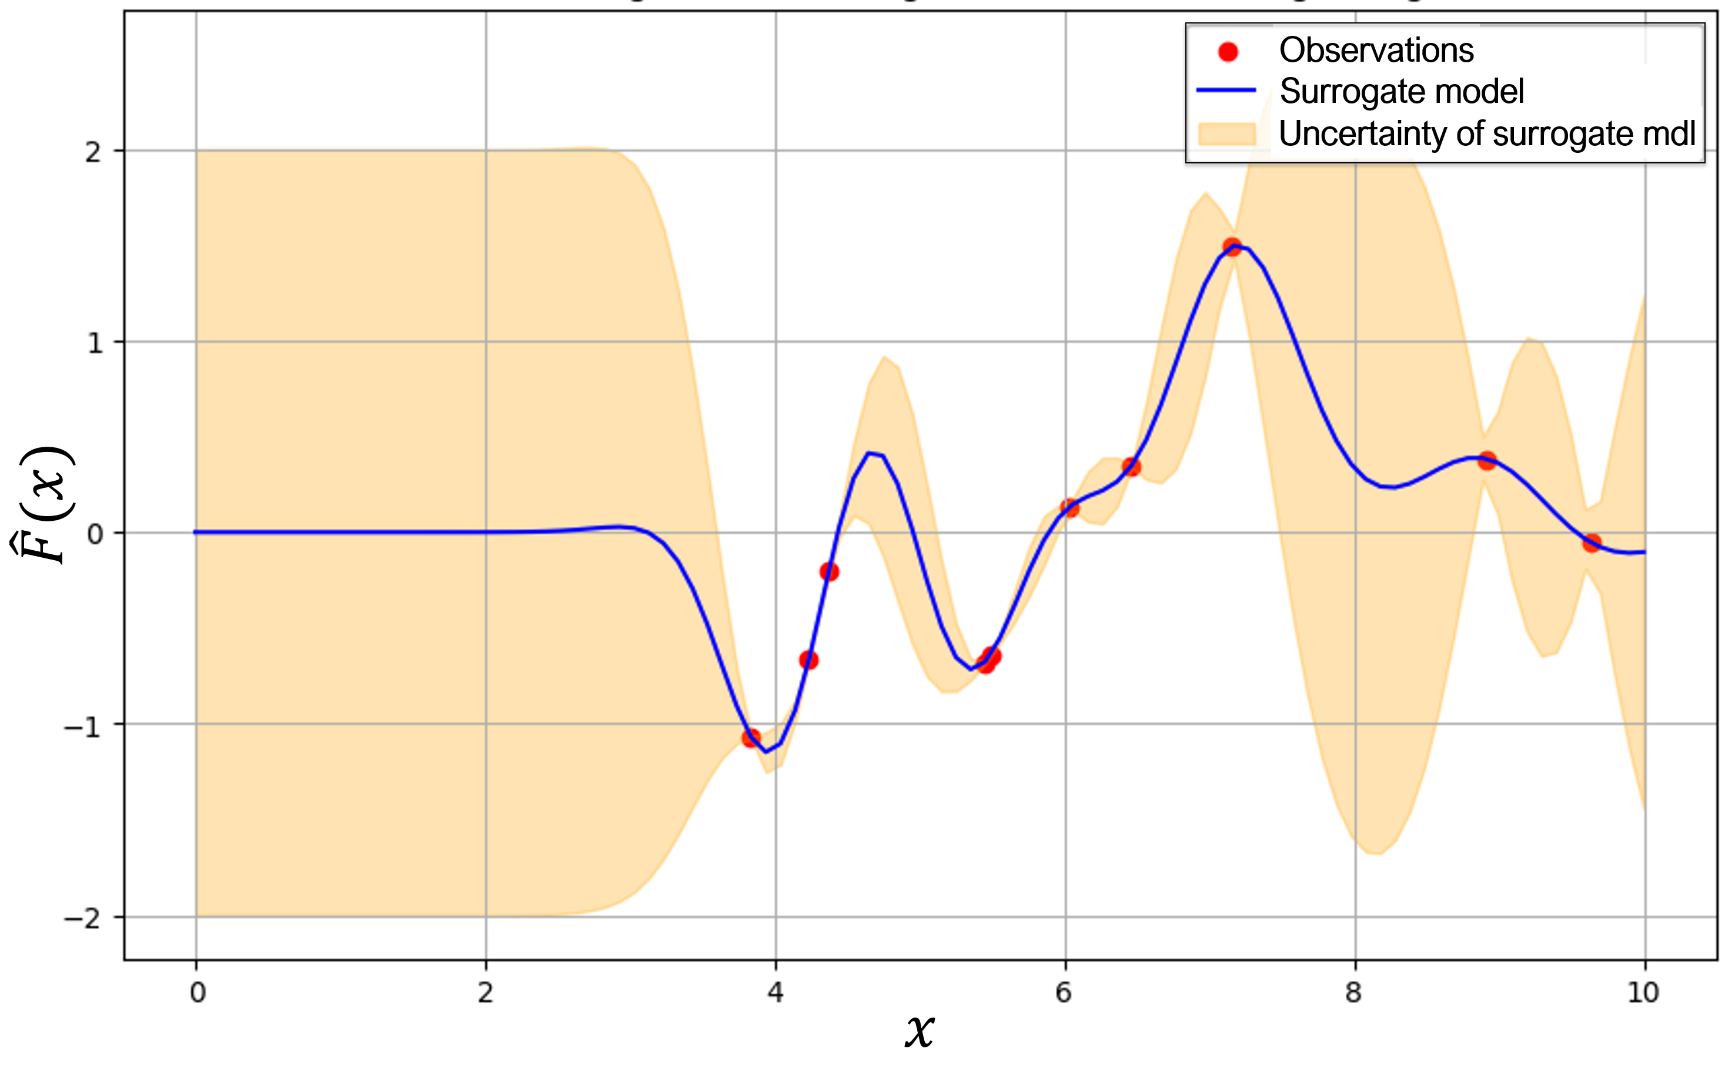
Future R&D
Surrogate models and rule-mining
Visualization and dimensionality reduction
Dynamic environments (sequence of scenario configs)
Narrow digital twins for sensors
Already extending integration into stakeholder simulation frameworks (e.g., AFSIM); distributed computing
Vision: TEAAS as the T&E backbone for autonomous systems
Notes:
Surrogate models, with uncertainty… Allowing rule-mining…
[→] Visualization and dimensionality reduction…
[→] Extending to dynamic environments…
[→] Focus on accurate sensor models…
[→] Other simulation frameworks…
[→] We want to built TEAAS to be the T&E backbone for autonomous systems

Slide 14
Steve Snarski – MTSI, VA
steve.snarski@mtsi-va.com
Project PI, LiDAR modeling
Alberico Menozzi – Novus LLC, NC
amenozzi@protonmail.com
Autonomy GNC, UQ
Brandon Persons – Persons Industries, AL
brandon.persons@personsindustries.com
Software development (NVIDIA), robotics
David Lazar – MTSI, VA
david.lazar@mtsi-va.com
Software development (AFSIM), AI/ML
Noel Khan – Eight Queens, CA
noelkhan@verizon.net
CIO, AI/ML
Questions

